Slide 1
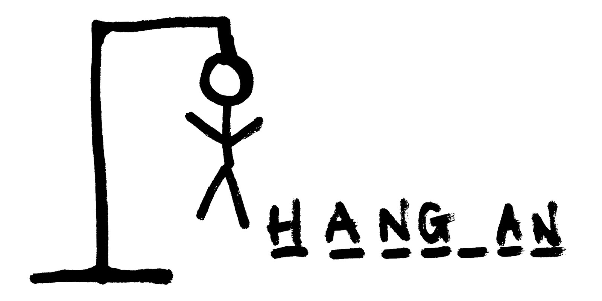
The Queens
By Alden Boby, Lukhanyiso Brukwe
Olwethu Dhlomo, Bulumko , Majezi

Slide 2
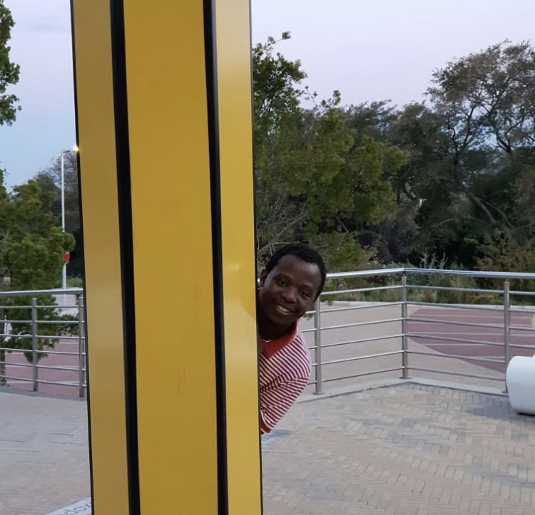
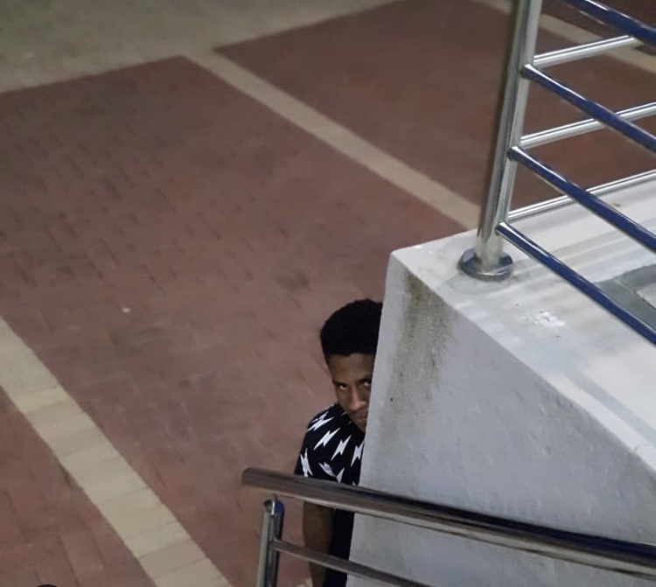
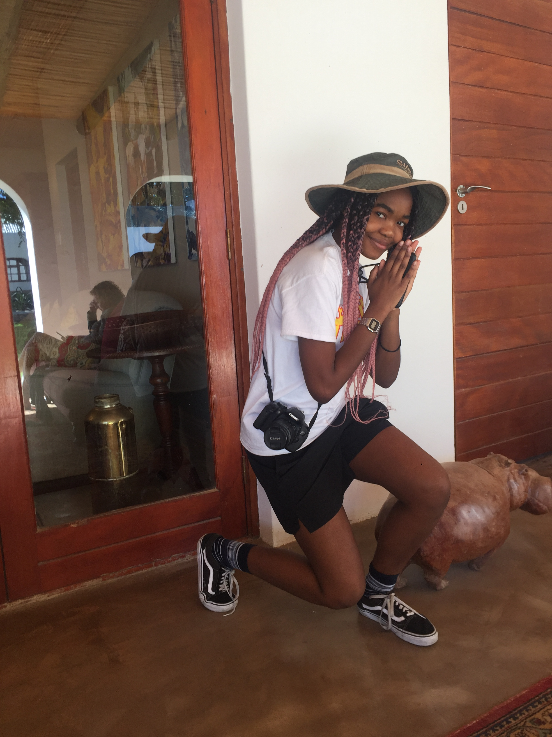
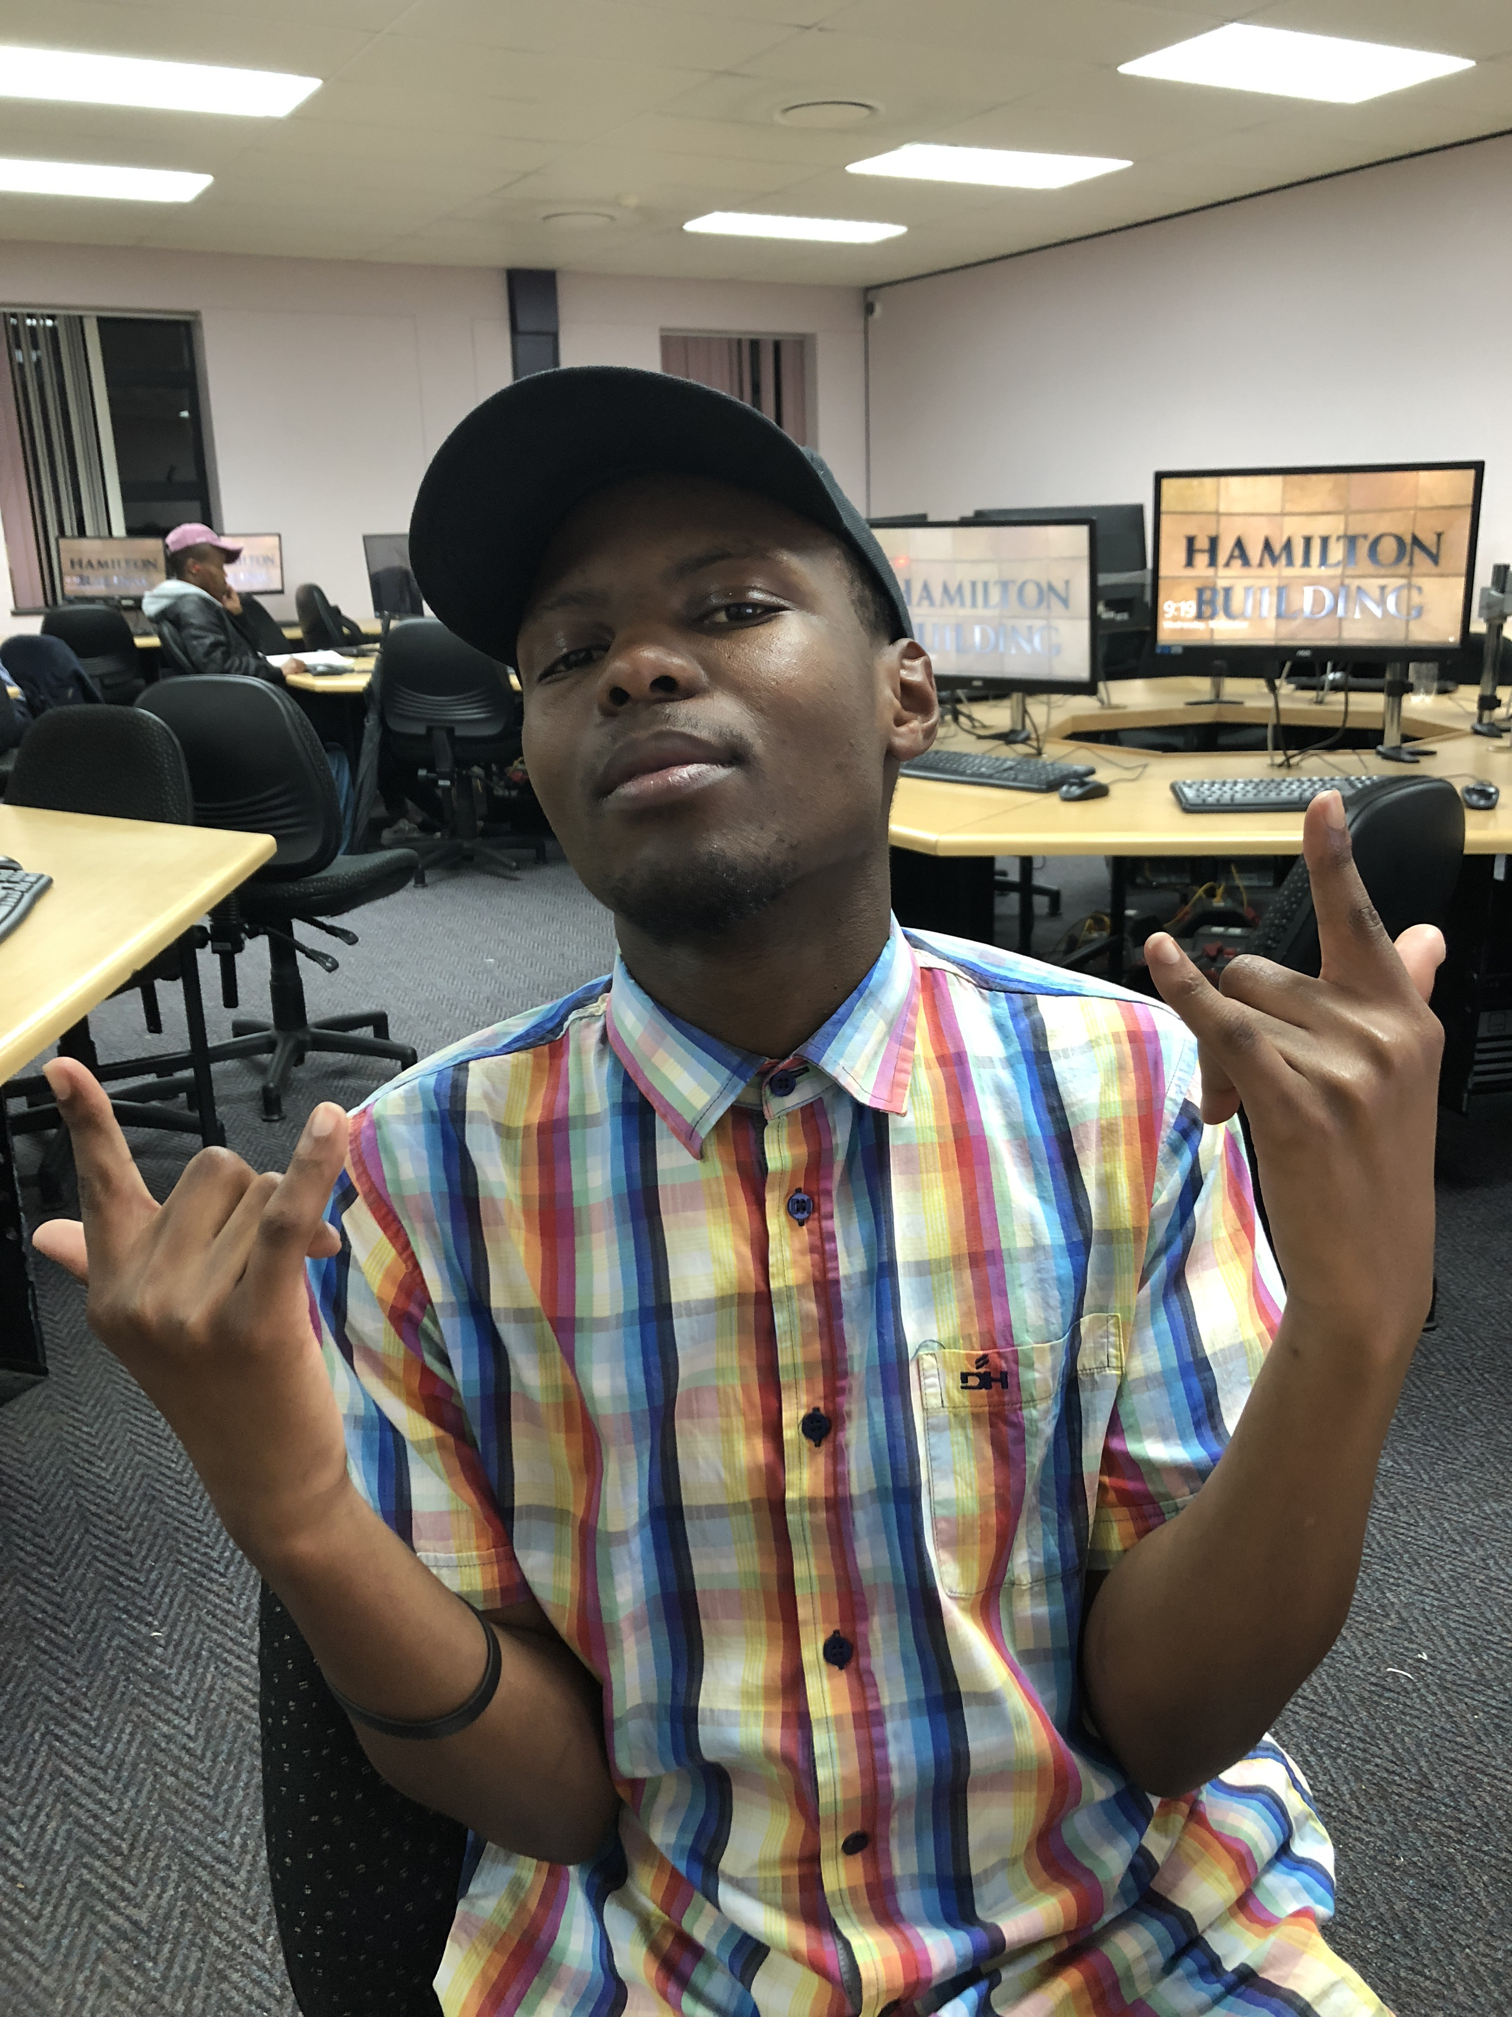
Positions
Bulumko - Queen B (Lead programmer)
Alden - Chief Designer
Olwethu – TXT compiler
Lukhanyiso – Debugger and Tester

Slide 3
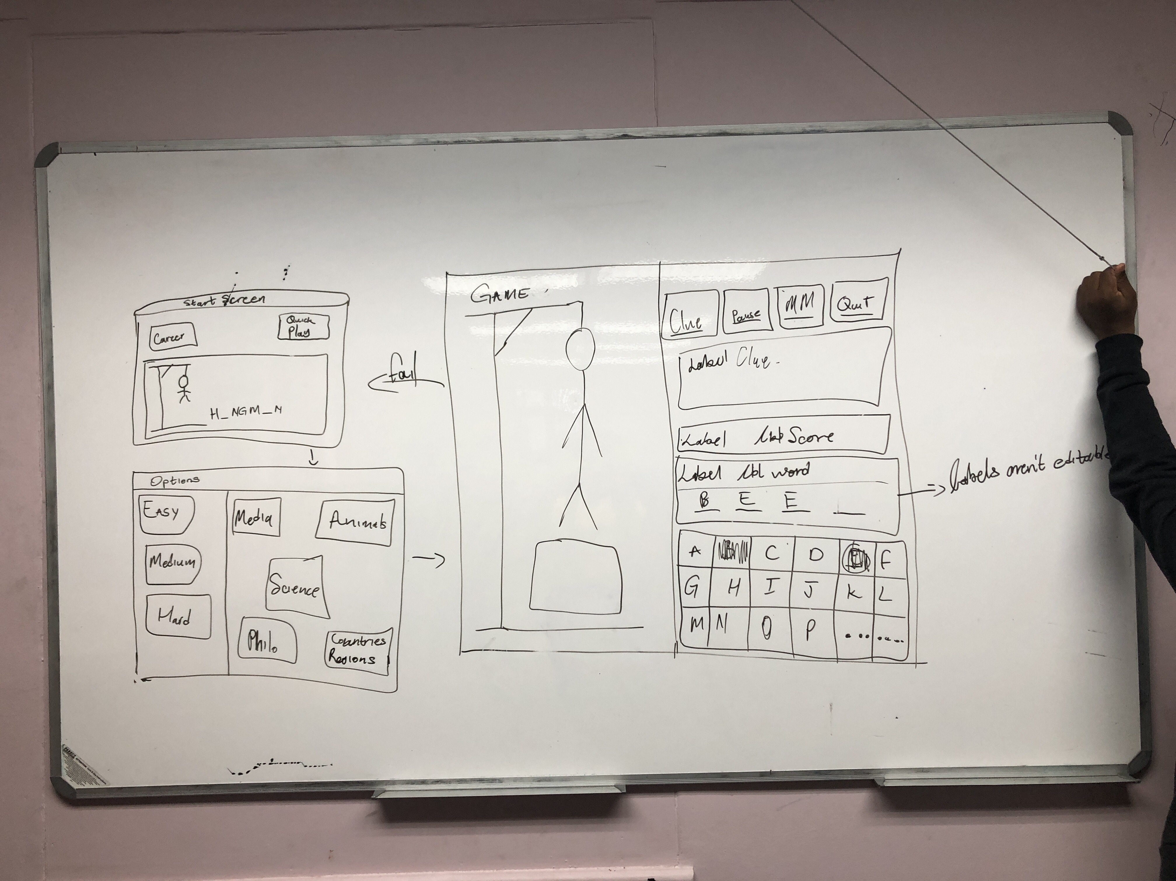
process
Meetings every Sunday and Monday to brainstorm and code
During the week we had meetings with Allen and Vongai
We had challenges with reading in a file, compiling the turtle, letter verification

Slide 4
objectives
Game has 2 options : Career Mode and Quick Play.
You initially choose the difficultly and categories
Guess the word and progress to the next level
If the letter is incorrect, then the structure of hangman will slowly assemble

Slide 5
How the code run
It works

Slide 6
Thank you

